Slide 1
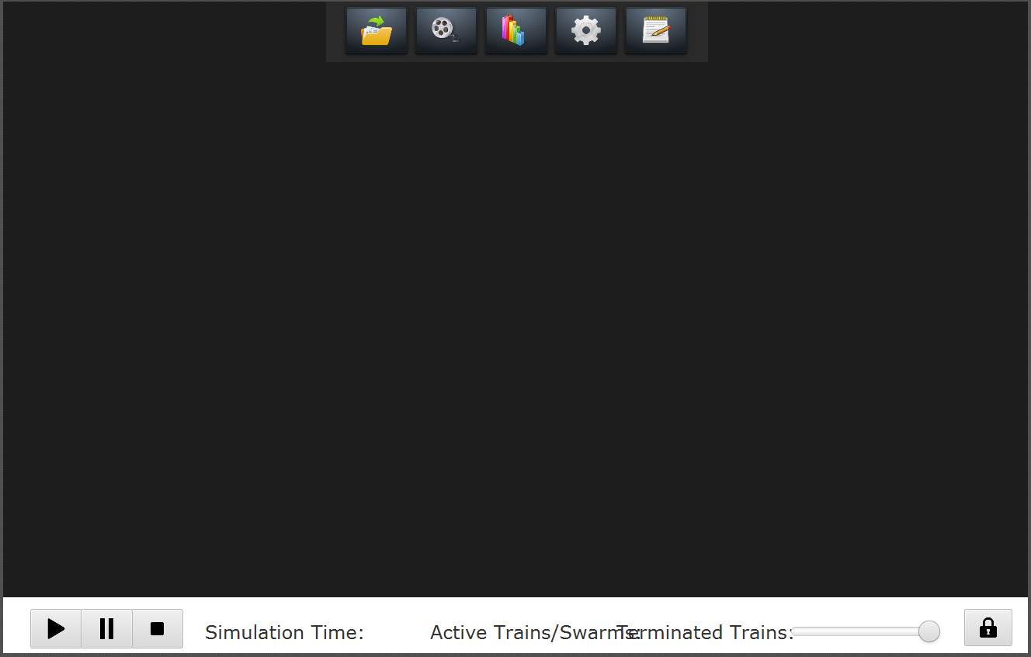

SimulationViewer
menuPane
controlPane
Defined in: SimulationViewer.fxml
simulationPane
Defined in: SimulationViewerController.java
ConfigurationPaneController
NetworkPaneController
editorPane
NetworkPane
graphPane
GraphPaneController
InfrastructureElementPane
TrainPane

